Slide 1
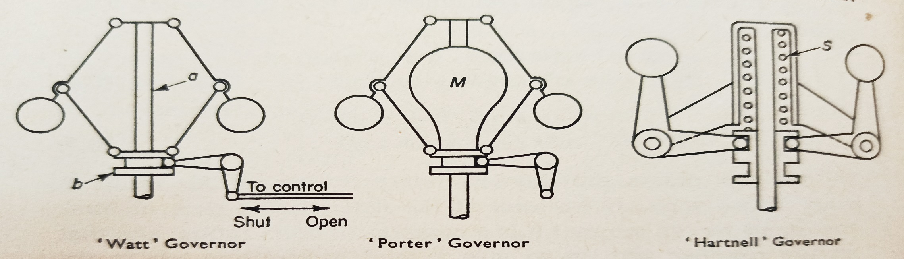
SIMPLE GOVERNOR
Engines are frequently required to run at an approximately constant speed irrespective of the power they are being asked to produce. The control could be a valve in the case of a steam engine, a throttle for a petrol engine, a fuel-pump setting for an oil engine, and so on: the device to set the control at the appropriate level is called a governor. Thus governor is a device backed by a mechanism to control the speed within prescribed range during entire operation of the machine.
[Important: Though both devices are meant for controlling the speed of operation of the machine, what are the essential differences of operation between a flywheel and a governor? – See book.]
Types of Governors: (1) Centrifugal Governors; (2) Inertia Governors
Our study will be limited within Centrifugal Governors only :
Watt Governor, (2) Porter Governor, (3) Hartnell Governor (spring loaded)

Slide 2
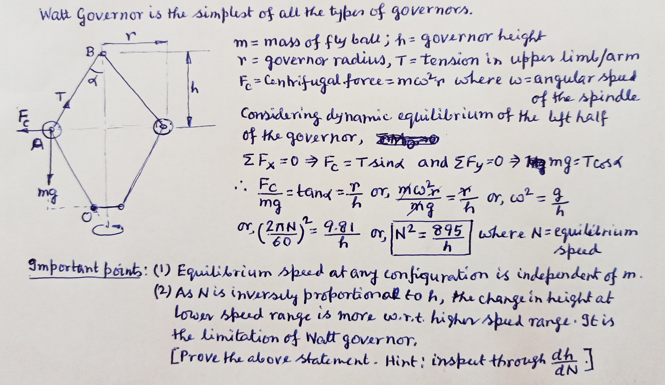
Terms Used in Governor
Height of governor; (2) Radius of governor; (3) Equilibrium speed; (4) Mean equilibrium speed; (5) Maximum and minimum equilibrium speed and speed range; (6) Sleeve lift. – See book.

